Slide 1
Domain-Specific Architectures for Deep Neural Networks:
10 Fallacies and Pitfalls
David Patterson
UC Berkeley and Google
June 23, 2019

Slide 2
Fallacies and Pitfalls affecting Systems for ML
Commonly held misbelief or misconceptions that you might encounter
Fallacy: Misbelief widely held
Pitfall: Easily made mistake (Often generalizations of principles that are true in a limited context)

Slide 3
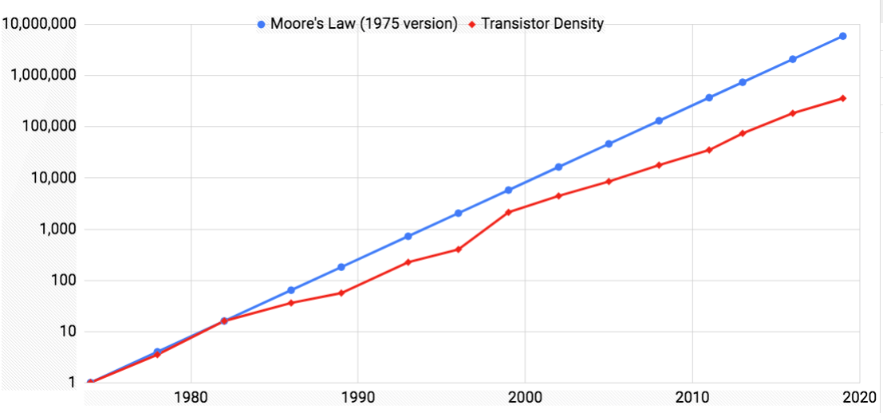
Fallacy #1: Moore’s Law isn’t dead!
15X
Moore, Gordon E. "No exponential is forever: but ‘Forever’ can be delayed!" Solid-State Circuits Conference, 2003.
Notes:
Since 2000 falling off Moore’s LAw
Off 10X number of transistors in a microprocessor if had stuck to Moore’s Law
What going to do next?

Slide 4
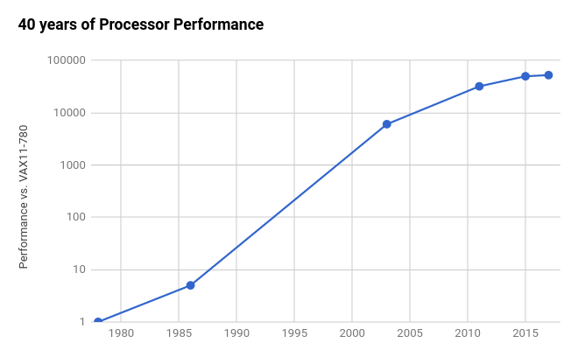
Fallacy #1: Moore’s Law isn’t dead!
We’re now in the Post Moore’s Law Era
End of the Line?
2X / 20 yrs
(3%/yr)
Am-
dahl’s
Law
⇒
2X / 6 yrs (12%/yr)
End of Dennard
Scaling
⇒
Multicore
2X / 3.5 yrs
(23%/yr)
RISC
2X / 1.5 yrs
(52%/yr)
CISC
2X / 3.5 yrs
(22%/yr)
Based on SPECintCPU. Source: John Hennessy and David Patterson, Computer Architecture: A Quantitative Approach, 6/e. 2018
Notes:
RISC - threw computers away since too slow
Have to rethink what we’re doing

Slide 5
Fallacy #2: Quantum Computing will soon rescue us from end of Moore’s Law
Google, IBM, Microsoft pursuing Quantum Computing
Physics, Math, Theory results are beautiful
For Cloud, not Client
#1 Recommendation of Quantum Workshop May 2018:*
First and foremost, there is an overarching need for new Quantum Computing algorithms that can make use of the limited qubit counts and precisions available in the foreseeable future. Without a “killer app” or at least a useful app runnable in the first ten years, progress may stall.
* “Next Steps in Quantum Computing: Computer Science’s Role,” May 22-23, 2018, Washington D.C., Computing Community Consortium
Notes:
Runs code before any OS code runs. Who reads that code?
Problems with large ISA?

Slide 6
Fallacy #2: Quantum Computing will soon rescue us from end of Moore’s Law
Quantum Computing - Progress and Prospects*
12/2018 consensus study from National Academies
"Significant technical and financial issues remain towards building a large, fault-tolerant quantum computer and one is unlikely to be built within the coming decade.”
Gwynne, Peter. (2019). “Practical quantum computers still at least a decade away.” Physics World. 32. 9-9. 10.1088/2058-7058/32/1/14.
*Mark Horowitz (Chair, NAE, Stanford, EE), Alán Aspuru-Guzik (U. Toronto, Chemistry), David Awschalom (NAE & NAS, U. Chicago, Physics), Robert Blakley (Citigroup), Dan Boneh (NAE, Stanford, CS), Susan Coppersmith (NAS, U. Wisconsin, Physics), Jungsang Kim (Duke, Physics & CS), John Martinis (UCSB & Google), Margaret Martonosi (Princeton, CS), Michele Mosca (U. Waterloo, Math & Physics), William Oliver (MIT, Physics), Krysta Svore (Microsoft), Umesh Vazirani (NAE, Berkeley, CS), National Academies, Washington D.C. https://www.nap.edu/catalog/25196/quantum-computing-progress-and-prospects
Notes:
Runs code before any OS code runs. Who reads that code?
Problems with large ISA?

Slide 7
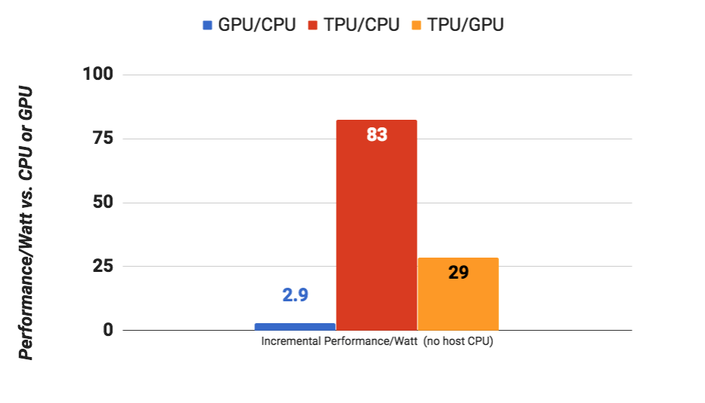
Pitfall #3: Not remembering computer architecture history
Ideas failed for general purpose computing can work fine for domain specific architectures
More effective parallelism:
SIMD vs. MIMD
VLIW vs. Speculative, out-of-order
More effective use of Memory Bandwidth
User controlled versus caches
TPUv1: Systolic Arrays, Decoupled Access/Execute, CISC (1970s)
Notes:
Need quantitative explanation why - SIMD less flexible but more efficient when it works
Caches fanttastic until they don’t work well - streaming,

Slide 8
Pitfall #4: Using IEEE Half Precision (16b) for ML
fp32: Single-precision IEEE Floating Point Format
Smallest number: 2⁻¹²⁶
Exponent: 8 bits
Mantissa (Significand): 23 bits
S
E
E
E
E
E
E
E
E
M
M
M
M
M
M
M
M
M
M
M
M
M
M
M
M
M
M
M
M
M
M
M
fp16: Half-precision IEEE Floating Point Format
Exponent: 5 bits
Smallest number: 2⁻¹⁴
(2¹¹² times larger!)
Mantissa (Significand): 10 bits
S
E
E
E
E
E
M
M
M
M
M
M
M
M
M
M
bfloat16: Brain Floating Point Format
Exponent: 8 bits
Mantissa (Significand): 7 bits
Smallest number: 2⁻¹²⁶
S
E
E
E
E
E
E
E
E
M
M
M
M
M
M
M

Slide 9
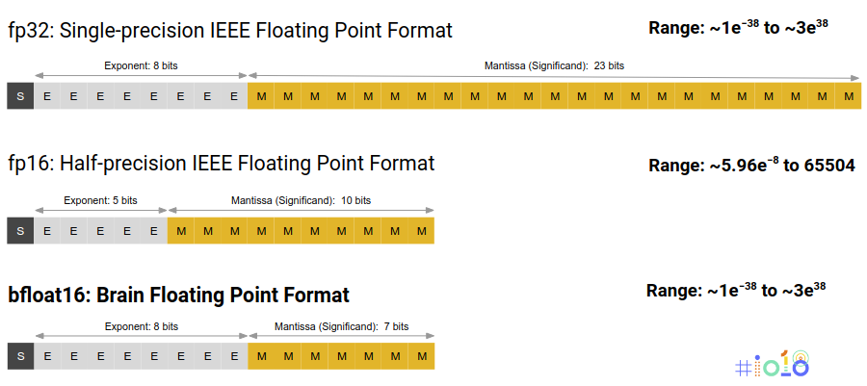
Pitfall #4: Using IEEE Half Precision (16b) for ML
Hardware: small mantissa reduces multiplier power, area float32: 23²=529 float16: 10²=100 bfloat16: 7²=49
Software: same dynamic range on number line, same Inf/NaN behavior as float.
Numerics: Unlike IEEE fp16, bfloat16 trains without loss scaling [Micikevicius 2017].
System: bfloat16 as an implementation technique inside the matrix multiplier.

Slide 10
Pitfall #5: Assuming given a sufficiently large speedup, ML researchers would be willing to sacrifice a little accuracy
But researchers can spend months improving accuracy by 2%
Accuracy in ML ~Correctness
Is 10X faster but slightly wrong answer a good result for general purpose computing?
Dean, Jeff, David Patterson, and Cliff Young. "A new golden age in computer architecture: Empowering the machine-learning revolution." IEEE Micro 38, no. 2 (2018): 21-29.

Slide 11
Fallacy #6: Given large size of the ML problems, hardware focus should be operations per second (throughput) rather than time to solution (latency)
Training: Often report TFLOPs/s per step, but real goal is elapsed time to converged accuracy
Inference/Serving: User facing, so often strict latency bounds (TPUv1)
Type | Batch | 99th% Response | Inf/s (IPS) | % Max IPS
CPU | 16 | 7.2 ms | 5,482 | 42%
CPU | 64 | 21.3 ms | 13,194 | 100%
GPU | 16 | 6.7 ms | 13,461 | 37%
GPU | 64 | 8.3 ms | 36,465 | 100%
TPUv1 | 200 | 7.0 ms | 225,000 | 80%
TPUv1 | 250 | 10.0 ms | 280,000 | 100%

Slide 12
Pitfall #7: Designing hardware using last year’s models
Architecture papers using MNIST, CIFAR-10, and AlexNet???
MNIST important historically, but 20 years old and primarily for student programming
CIFAR-10 image-recognition competition that ImageNet replaced in 2010 because too easy
AlexNet (kickstarted CNN revolution won ImageNet in 2012) is now old fashioned. Only 6 NN layers, recent champions have 150 layers
No more effective or persuasive than designing CPUs with quicksort/hashing
Dean, Jeff, David Patterson, and Cliff Young. "A new golden age in computer architecture: Empowering the machine-learning revolution." IEEE Micro 38, no. 2 (2018): 21-29.

Slide 13
Pitfall #7: Designing hardware using last year’s models
MLPerf Training 0.5 (Nov 18) – NVIDIA, Google and a little of Intel
MLPerf Training 0.6 (June 19) – NVIDIA, Google, Intel, 1 supercomputer
MLPerf Inference 0.5 (July 19) – ??
Why didn’t others submit?
Wanted to see results by competitors first
Their software stack is not ready
Their system is not ready (front end, I/O, …)
Their chip is not ready
Everything is ready, just not happy with results

Slide 14
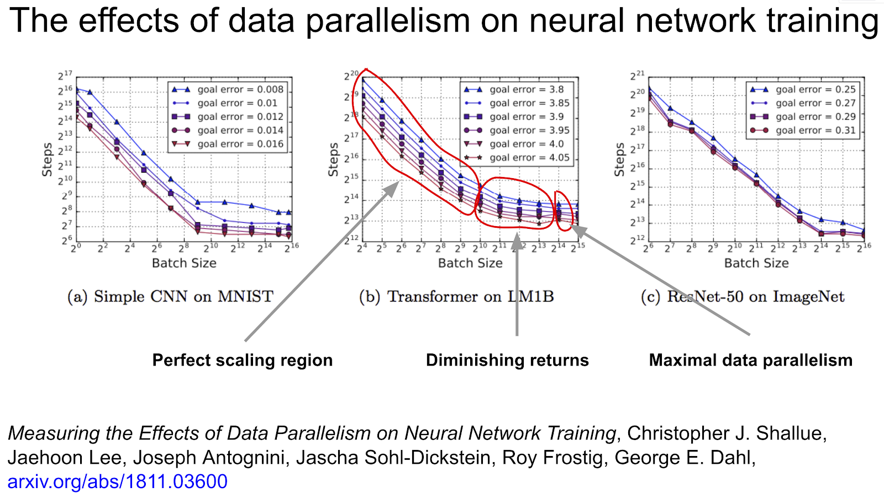
Pitfall #8: Not leveraging large batch size

Slide 15
Fallacy #9: ML ASICs are inflexible
Volume for ML accelerators sufficient to justify custom ASICs
Some apps don’t: e.g., gene sequencing should use FPGAs in the cloud?
Application Specific Integrated Circuit (ASIC) does not mean can’t change model type
ASIC is name of CAD flow and tools, not restriction to limited number of applications
Google TPU, Habana, (all startups) … are programmed in PyTorch or TensorFlow, so can adapt to different models
Software is a good idea!

Slide 16
Fallacy #10: Can keep increasing training compute at same rate as the past
Moore’s Law performance doubles
every 18 months
ML Training
From “AI and Compute.” Dario Amodei and Danny Hernandez, May 16, 2018
Moore’s Law

Slide 17
Since 2012, AI training state of
the art compute
demand 10X per year!
(Moore’s Law “only” 10X in 5 years)
ML Training
From “AI and Compute.” Dario Amodei and Danny Hernandez, May 16, 2018
Moore’s Law

Slide 18
Fallacy #10: Can keep increasing training compute at same rate as the past
10X per year to push the state of the training accuracy
Moore’s Law: 2X/2 years
Exponentials cannot last forever
How much longer can increase compute demand for training at 10X annually?

Slide 19
Current Neural Network Architecture Debate
Google TPU: 1 or 2 cores per chip, large 2D multiplier, software controlled memory (instead of caches)
NVIDIA GPU: 80 cores, many threads (20MB registers), small multipliers, caches, scatter/gather & coalescing HW
Microsoft FPGA: customize “hardware” to application
Intel CPU: 30+ cores, 3 levels of caches, SIMD instructions
Also bought Altera that supplies Microsoft’s FPGAs
Also bought Nervana, Movidius, MobilEye to offer custom chip DSA
> 100 startups with their own architecture bets

Slide 20
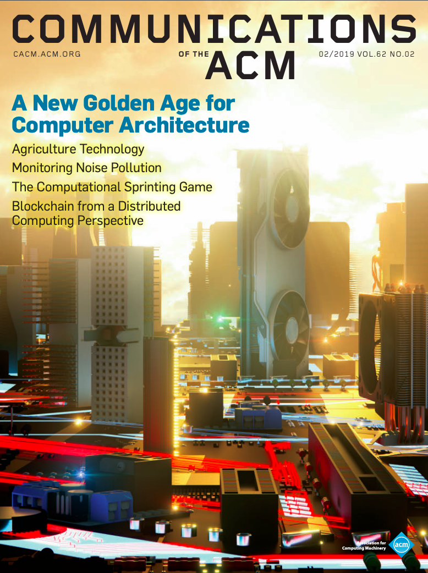
John Hennessy and David Patterson, “A New Golden Age for Computer Architecture,” Communications of the ACM, February 2019

